Slide 1
Exploratory Data Analysis (EDA) & Preprocessing on Titanic Dataset
Ramdular Yadav
Machine Learning Engineer

Slide 2
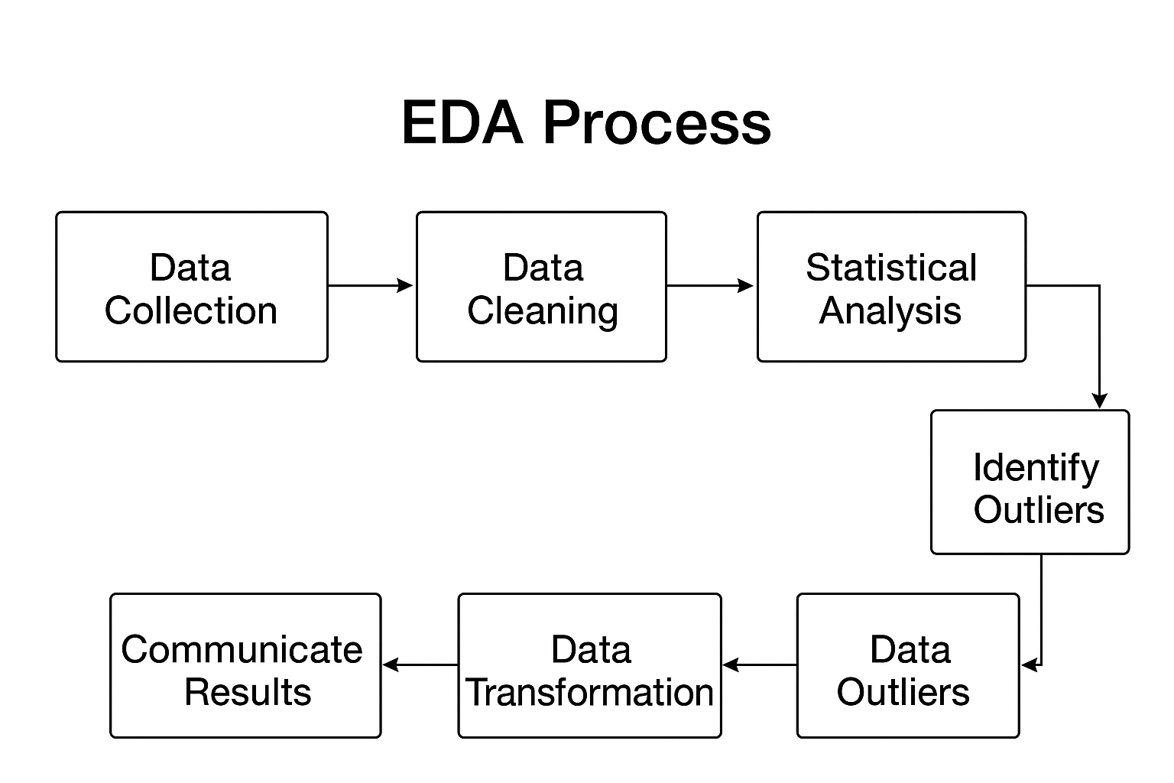
Introduction to EDA
process of using statistical summaries and data visualization to understand the main characteristics of a dataset
Notes:
It is a critical first step in any data science project to inspect, clean, and prepare data before building a model.

Slide 3
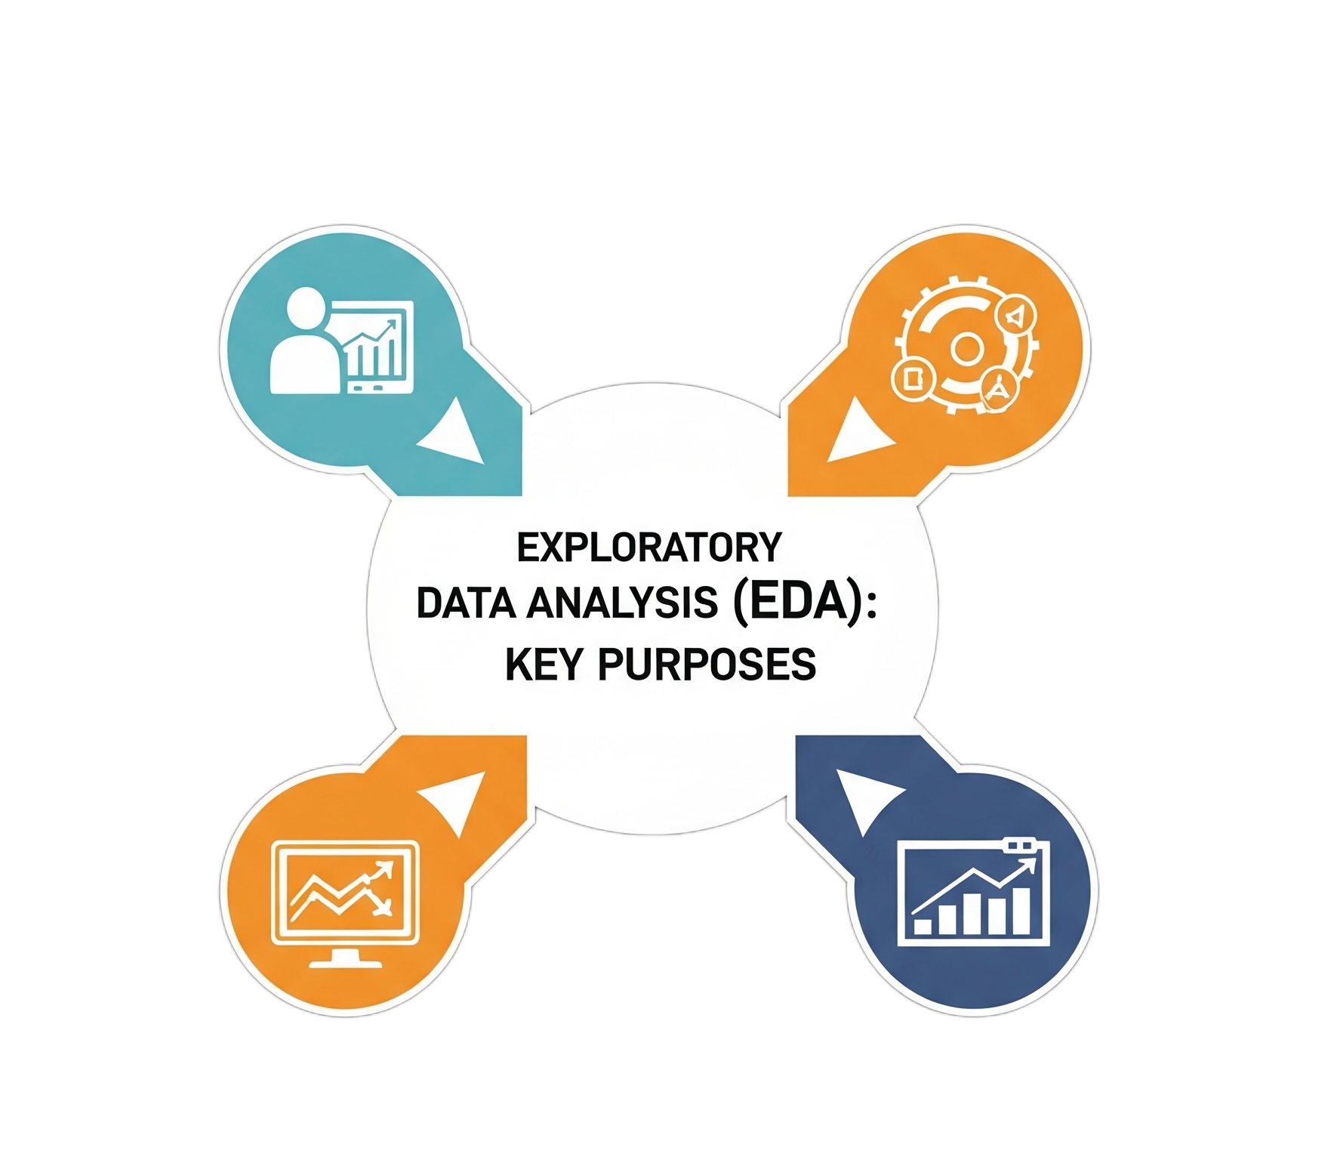
Main purposes of EDA
Generate hypotheses
Find anomalies
Understand variable relationships
Ensure data quality
Select appropriate models
Notes:
It is a critical first step in any data science project to inspect, clean, and prepare data before building a model.

Slide 4
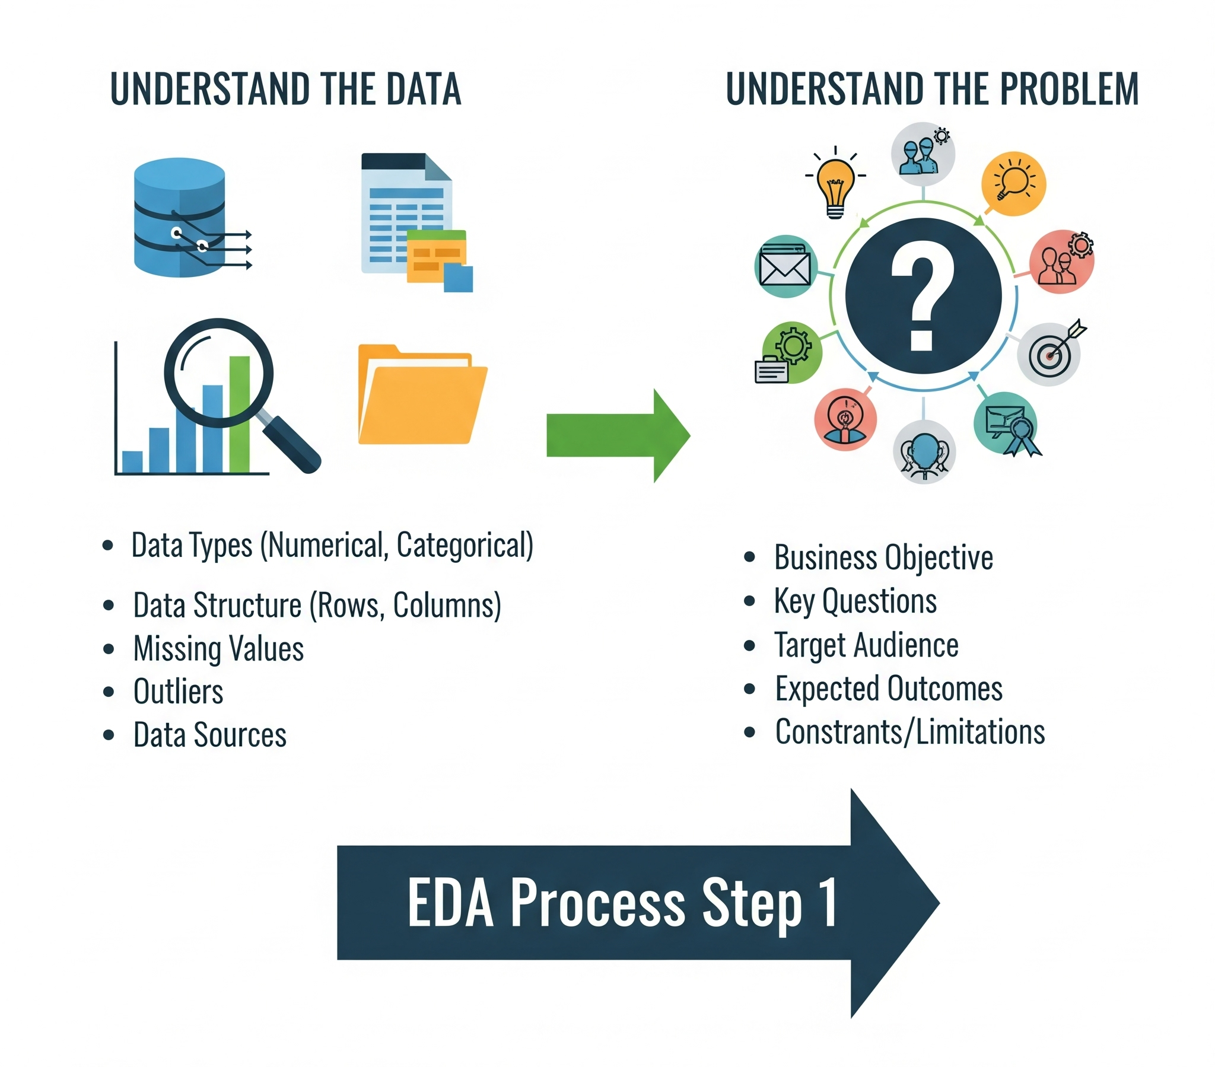
EDA process
1. Understand the data and the problem
Notes:
It is a critical first step in any data science project to inspect, clean, and prepare data before building a model.

Slide 5
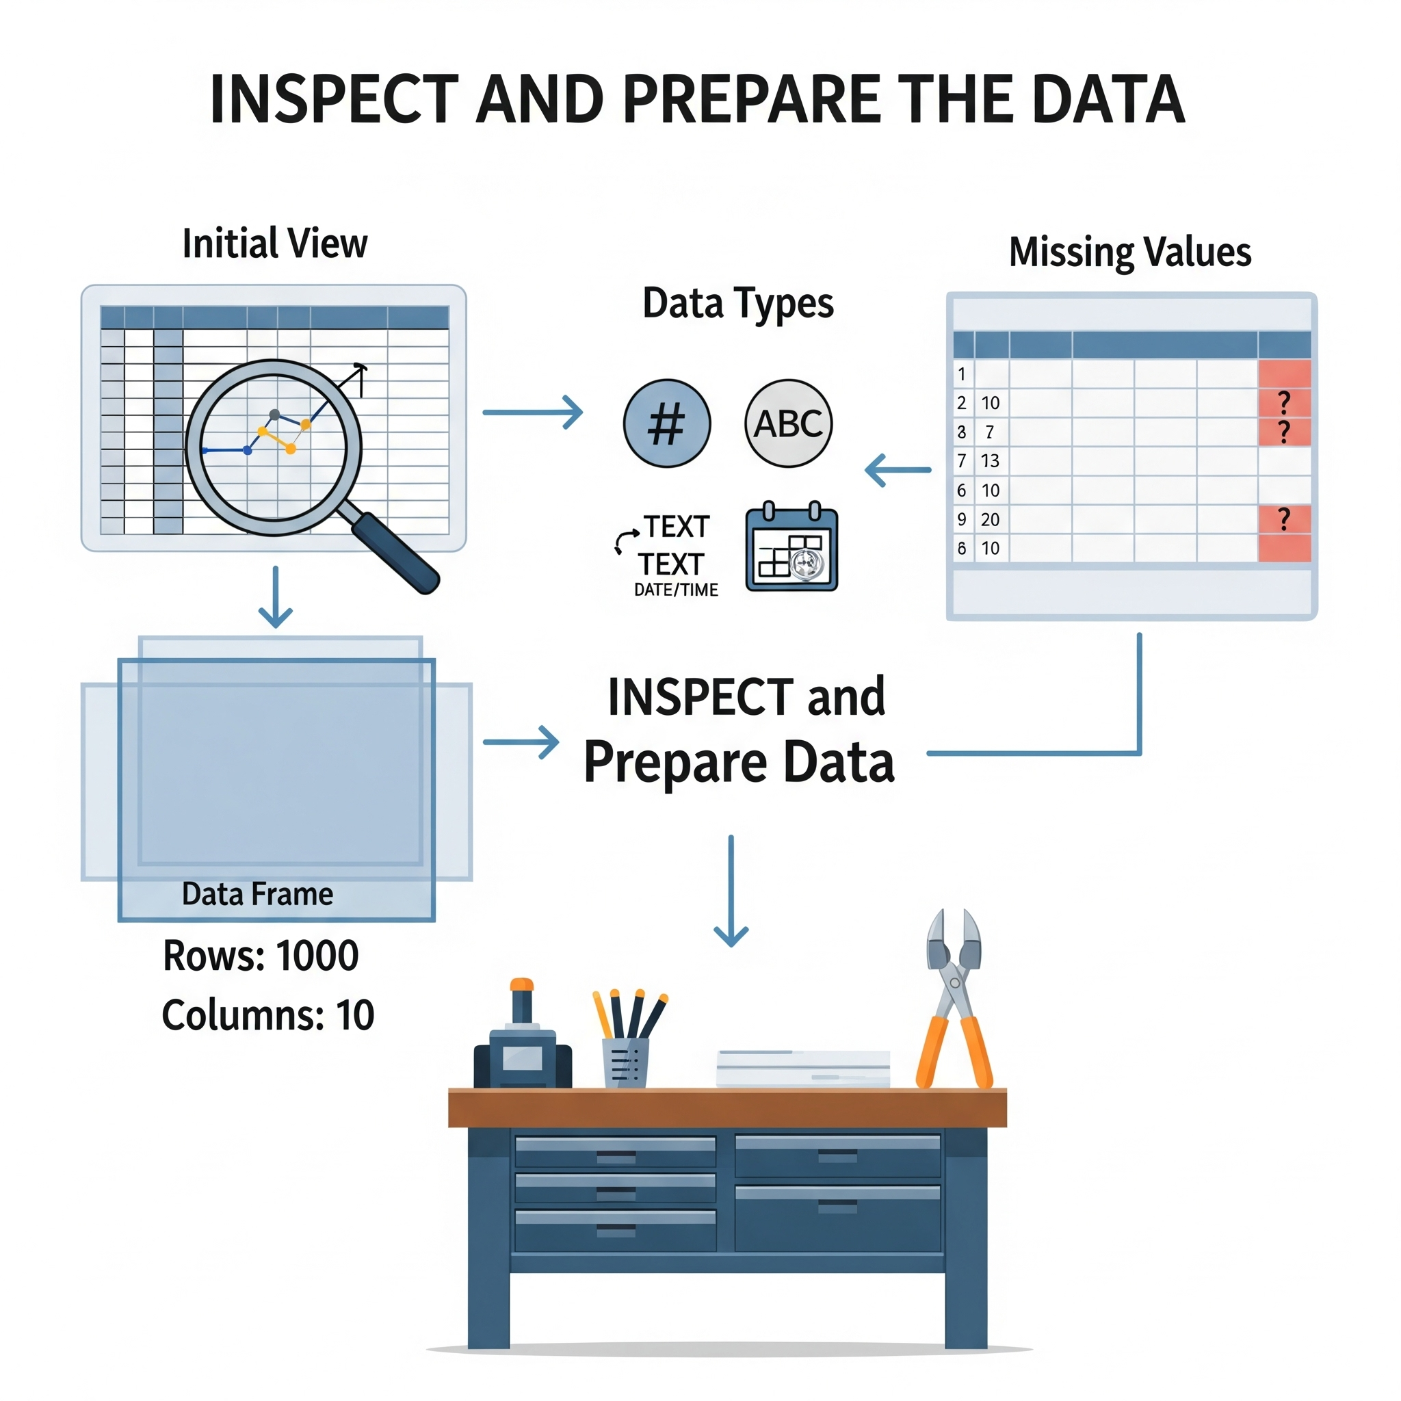
EDA process
2. Inspect and prepare the data
Size and shape
Initial view
Data types
Missing values
Notes:
It is a critical first step in any data science project to inspect, clean, and prepare data before building a model.

Slide 6
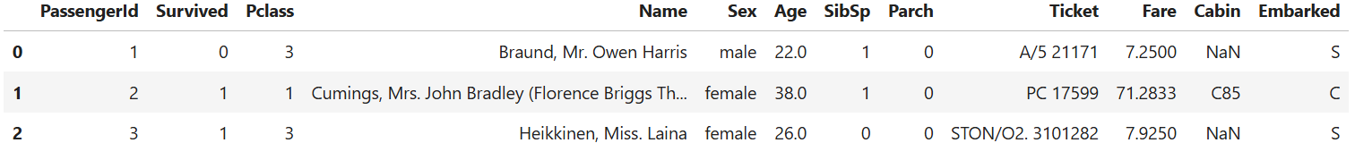
Dataset Overview
Objective: Explore Titanic dataset, clean data, preprocess features for modeling.
Dataset details: 891 rows × 12 columns
Target variable: Survived (0 = No, 1 = Yes).
Notes:
It is a critical first step in any data science project to inspect, clean, and prepare data before building a model.

Slide 7
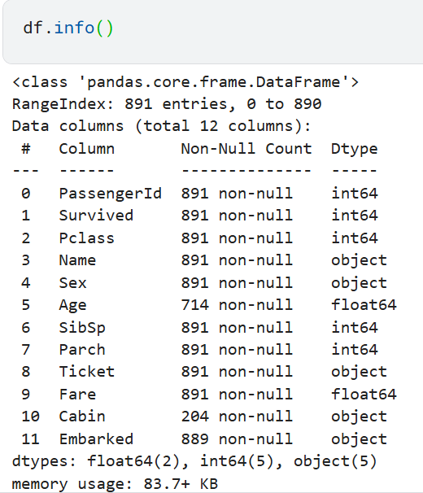
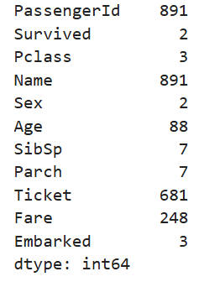
Dataset Overview
Show dataset structure (df.info())
Numerical (Age, Fare, SibSp, Parch)
Categorical (Sex, Embarked, Pclass)
High-cardinality (Name, Ticket, Cabin).
Notes:
It is a critical first step in any data science project to inspect, clean, and prepare data before building a model.

Slide 8
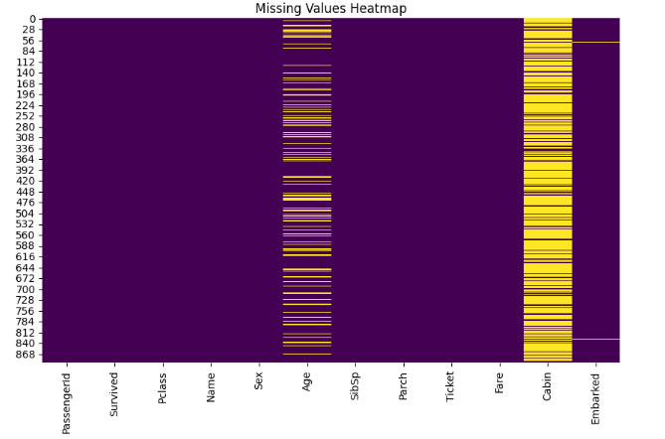
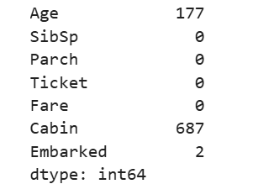
Missing Values
Missing Values HeatMap:
Found missing values in:
Missing_counts = df.isnull().sum()
Age → 19.87%
Cabin → 77.10%
Embarked → 0.22%
Notes:
It is a critical first step in any data science project to inspect, clean, and prepare data before building a model.

Slide 9
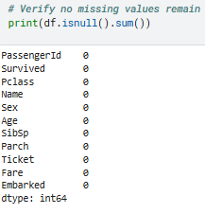
Handle Missing Values
Embarked: Fill with mode (most frequent value, likely 'S') due to only 0.22% missing.
Age: Fill with median to handle 19.87% missing, as it’s robust to outliers.
Cabin: Drop due to 77.10% missing, as imputation would introduce significant bias. Cabin is often correlated with Pclass or Fare, which capture similar information (socioeconomic status/deck location)
Notes:
It is a critical first step in any data science project to inspect, clean, and prepare data before building a model.

Slide 10
EDA process
3. Visualize the data
Data visualization is a core component of EDA, using graphical representations to easily spot patterns, trends, and outliers that might be difficult to see in raw numbers.
Univariate analysis (single variable):
Histogram - frequency distribution
Bar chart: Shows the distribution of a categorical variable.
Box plot: Summarizes the five-number summary
Notes:
It is a critical first step in any data science project to inspect, clean, and prepare data before building a model.

Slide 11
EDA process
4. Visualize the data
Bivariate and multivariate analysis (two or more variables):
Scatter plot: Visualizes the relationship between two continuous variables.
Heatmap: Displays the correlation matrix
Notes:
It is a critical first step in any data science project to inspect, clean, and prepare data before building a model.

Slide 12
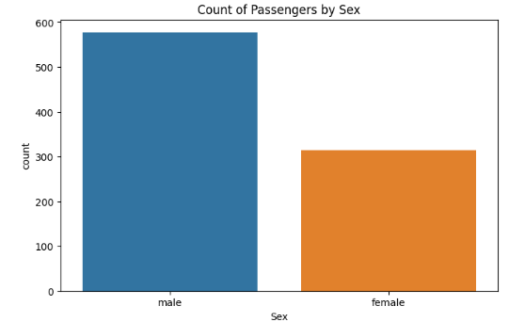
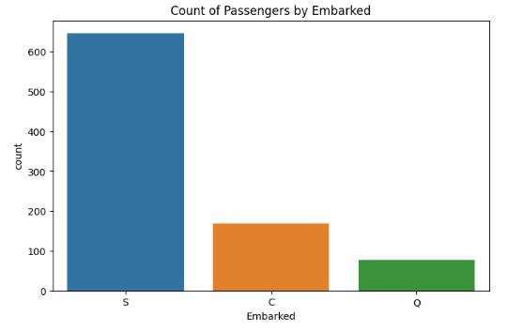
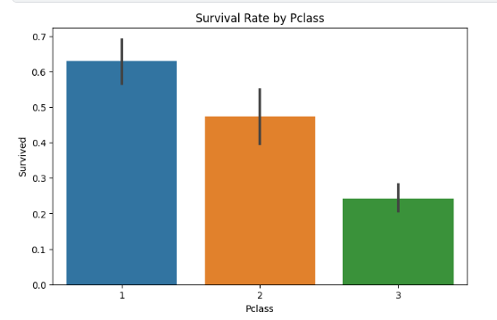
Exploratory Visualizations
Notes:
It is a critical first step in any data science project to inspect, clean, and prepare data before building a model.

Slide 13
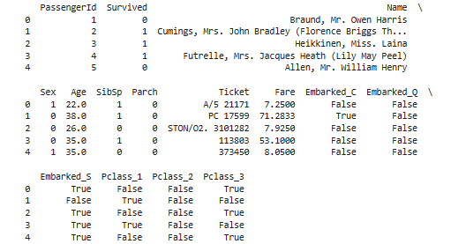
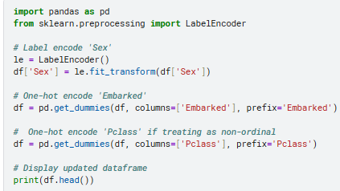
Encoding Categorical Features
Sex: 2 categories (male, female) → Use LabelEncoder (binary).
Embarked: 3 categories (S, C, Q) → Use OneHotEncoder (non-ordinal).
Pclass: 3 categories (1, 2, 3) → Treat as ordinal (numerical)
Name, Ticket: High cardinality (many unique values), drop unless engineered.
PassengerId: Unique identifier, drop.
Notes:
It is a critical first step in any data science project to inspect, clean, and prepare data before building a model.

Slide 14
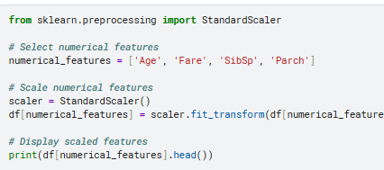

Scaling Numerical Features
StandardScaler applied to:
Age, Fare, SibSp, Parch.
All features rescaled to mean = 0, std = 1.
Reason: Prepare for ML models sensitive to scale.
Notes:
It is a critical first step in any data science project to inspect, clean, and prepare data before building a model.

Slide 15
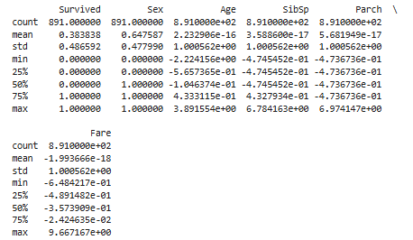
EDA process
3. Perform statistical analysis
This stage uses descriptive statistics to get a numerical summary of the data, especially for continuous variables.
print(df.describe())
Notes:
It is a critical first step in any data science project to inspect, clean, and prepare data before building a model.

Slide 16
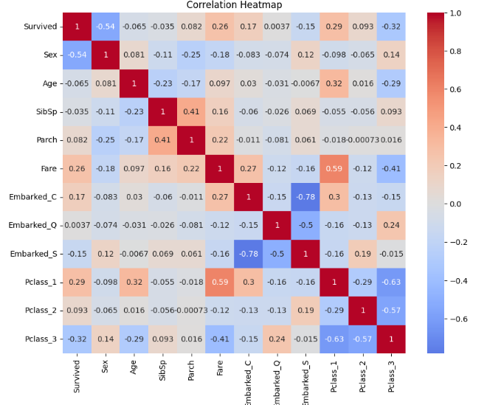
Correlation Analysis
Correlation heatmap (numeric + encoded features).
Insights:
Strong correlation between Pclass & Fare.
Sex correlates with survival.
SibSp & Parch moderately correlated (family traveling together).
Notes:
It is a critical first step in any data science project to inspect, clean, and prepare data before building a model.

Slide 17
Final Cleaned Dataset
After preprocessing:
Rows: 891
Columns: Reduced (dropped unnecessary + encoded features).
Data is now: No missing values, scaled numerics, encoded categoricals.
Ready for ML modeling.
Notes:
It is a critical first step in any data science project to inspect, clean, and prepare data before building a model.

